Slide 1
Algorithms
Lecture 3
Sorting with Divide and Conquer
Muhammad Ehsanul Kader
Lecturer
Department of Computer Science and Engineering
BRAC University

Slide 2
Stable Sorting algorithm
A sorting algorithm is stable if it maintains the relative order of equal elements. For example, if two elements have the same value, their order remains the same as in the input array.
Example
Input: [(4, 'apple'), (2, 'banana'), (4, 'pear')]
Stable Sort Result (sorted by the left element): [(2, 'banana'), (4, 'apple'), (4, 'pear')]
Unstable Sort Result (sorted by the left element): [(2, 'banana'), (4, 'pear'), (4, 'apple')]
Stable sorting is important when multiple criteria are involved, and the order of equal elements matters.

Slide 3
Inplace Sorting algorithm
An in-place sorting algorithm uses a constant amount of extra space for producing the final sorted array. The sorting is done within the original array with only a small, constant amount of extra storage.
Example
Quick Sort: Uses a divide-and-conquer approach but sorts elements within the array.
Insertion Sort: Inserts elements into their correct position within the array without needing extra space.

Slide 4
Bubble Sort
def bubble_sort(arr):
n = len(arr)
for i in range(n-1):
for j in range(n-i-1):
if arr[j] > arr[j+1]:
temp = arr[j]
arr[j] = arr[j+1]
arr[j+1] = temp
Worst Case Complexity? Best Case Complexity?
Space Complexity?
Optimization?
Notes:
Time Complexity:
Best Case: In optimized version: O(n) when array is in sorted order Average Case: O(n^2) when array is in random order. Worst Case: O(n^2) when array is in reverse order.
Space Complexity:
Best/Average/Worst case: O(1)
Stable: Yes.
Inplace: Yes.
Suitable for smaller arrays. Unsuitable for larger arrays and when lesser swapping is preferred.

Slide 5
Selection Sort
def selection_sort(arr):
n = len(arr)
for i in range(n):
min_idx = i
for j in range(i+1, n):
if arr[j] < arr[min_idx]:
min_idx = j
arr[i], arr[min_idx] = arr[min_idx], arr[i]
Worst Case Complexity? Best Case Complexity?
Space Complexity?
Optimization?
Notes:
Time Complexity:
Best Case: O(n^2) when array is in sorted order Average Case: O(n^2) when array is in random order. Worst Case: O(n^2) when array is in reverse order.
Space Complexity:
Best/Average/Worst case: O(1)
Stable: Yes.
Inplace: Yes.
Suitable for smaller arrays. Unsuitable for larger arrays and when lesser swapping is preferred.

Slide 6
Insertion Sort
def insertion_sort(arr):
n = len(arr)
for i in range(1, n):
key = arr[i]
j = i - 1
while j >= 0 and key < arr[j]:
arr [j+1] = arr[j]
j = j -1
arr[j+1] = key
Worst Case Complexity? Best Case Complexity?
Space Complexity?
Optimization?
Notes:
Time Complexity:
Best Case: O(n) when array is sorted already. Average Case: O(n^2) when array is in random order. Worst Case: O(n^2) when array is in reverse order.
Space Complexity:
Best/Average/Worst case: O(1).
Stable: Yes.
Inplace: Yes.
Suitable for smaller arrays and when a few elements needs to be sorted. Unsuitable for larger arrays.

Slide 7
Divide and Conquer Strategy
Divide
the problem (instance) into subproblems.
the subproblems by solving these recursively (or iteratively).
Conquer
Combine
the solutions to the subproblems.

Slide 8
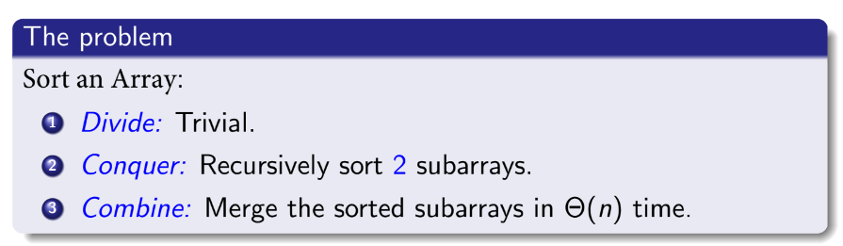
Merge Sort

Slide 9
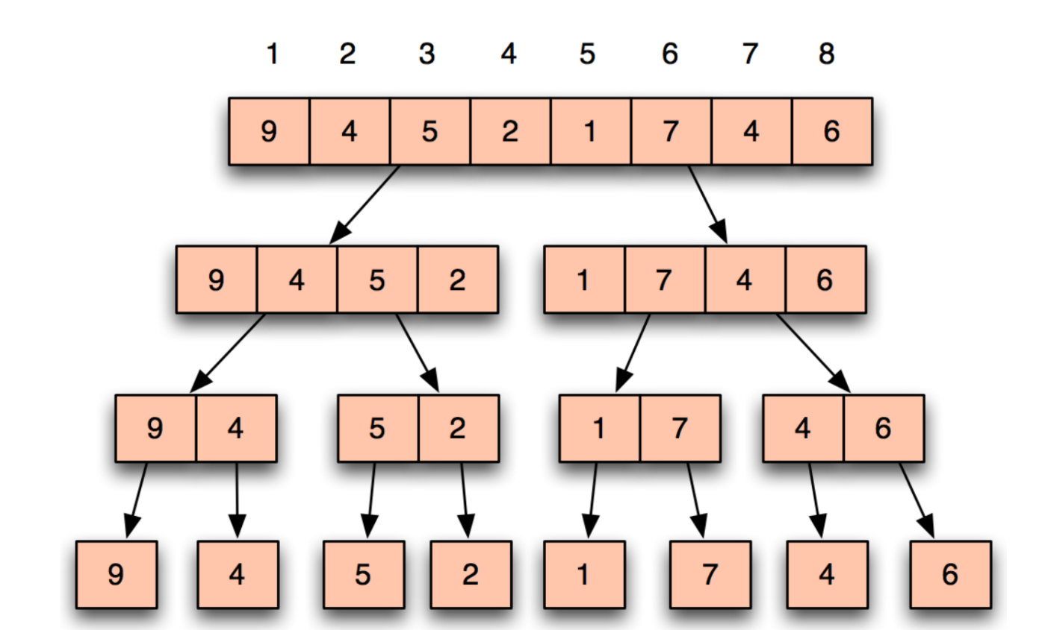
Merge Sort (Simulation)

Slide 10
Merge Sort (Simulation)

Slide 11
Merge Sort (Simulation)

Slide 12
Merge Sort (Simulation)

Slide 13
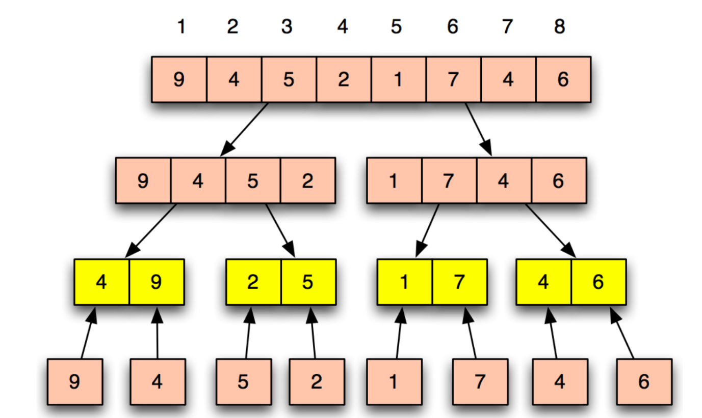
Merge Sort (Simulation)

Slide 14
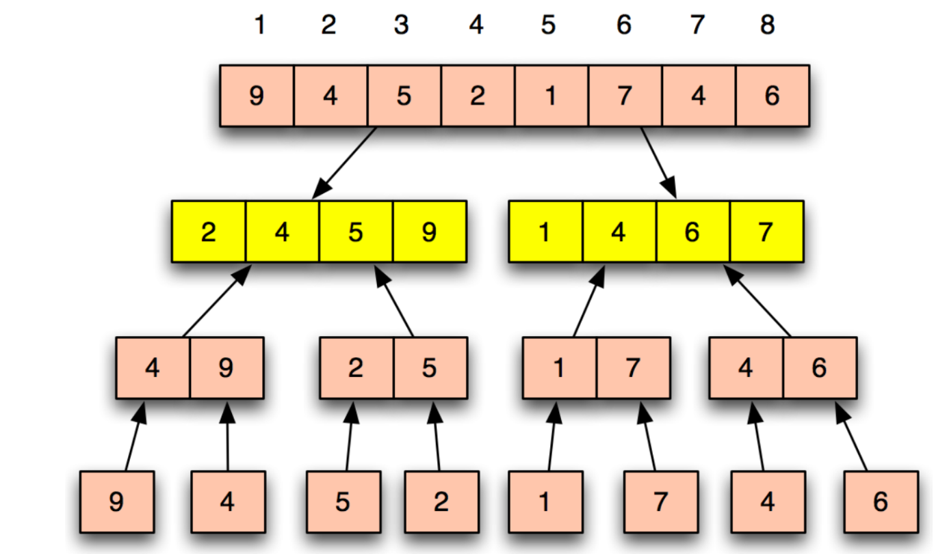
Merge Sort (Simulation)

Slide 15
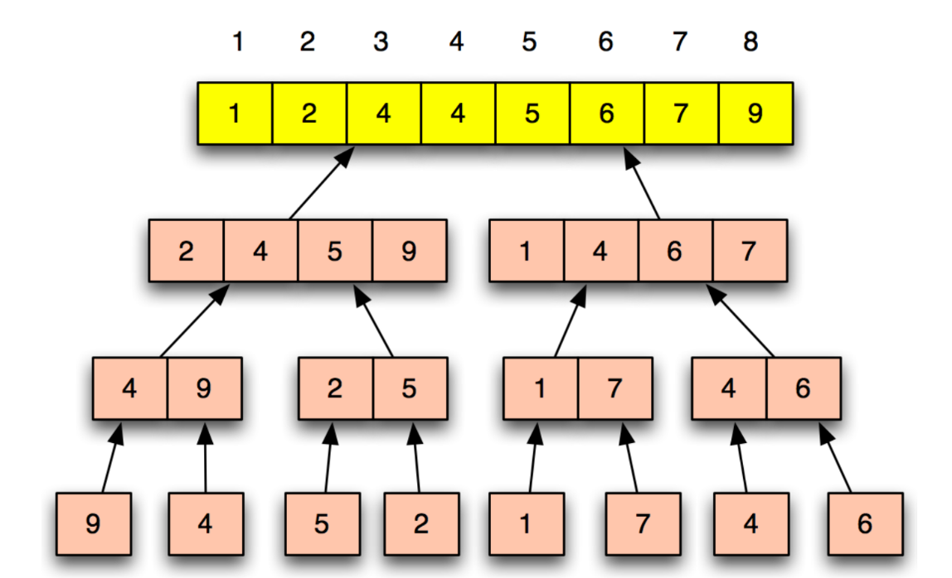
Merge Sort (Simulation)

Slide 16
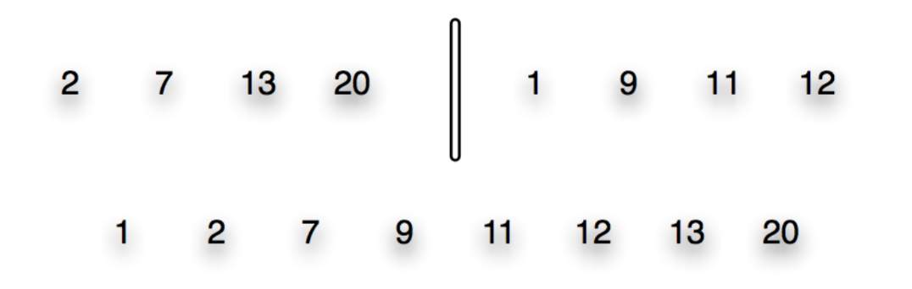
Merge (Simulation)

Slide 17
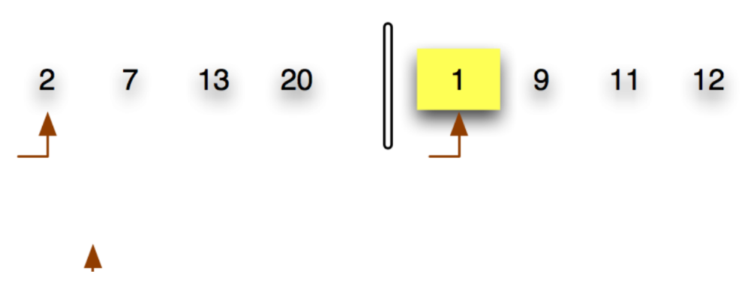
Merge (Simulation)

Slide 18
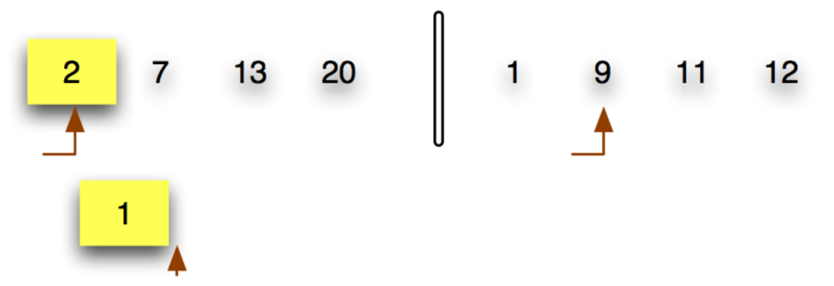
Merge (Simulation)

Slide 19
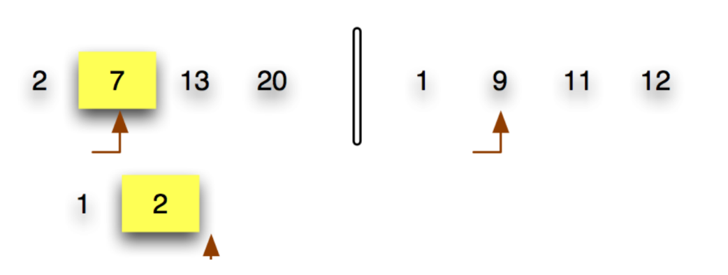
Merge (Simulation)

Slide 20
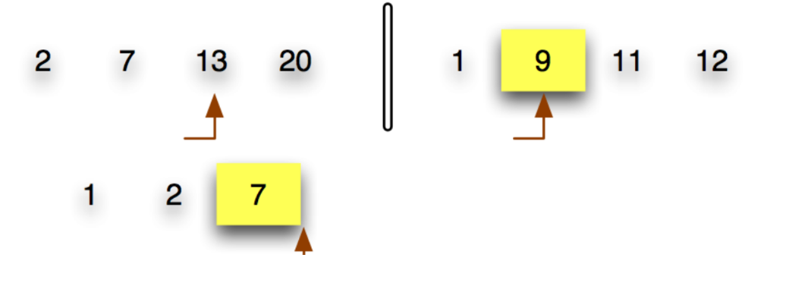
Merge (Simulation)

Slide 21
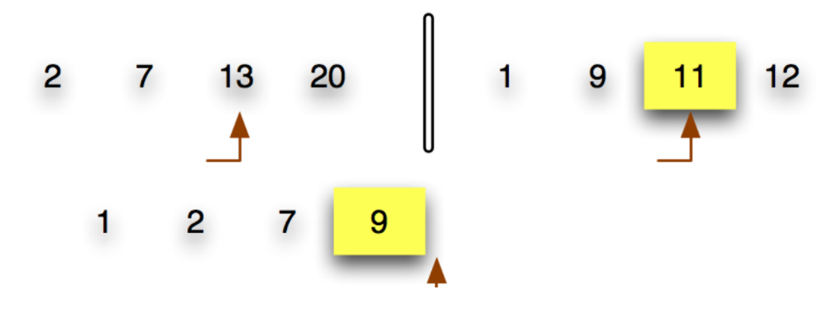
Merge (Simulation)

Slide 22
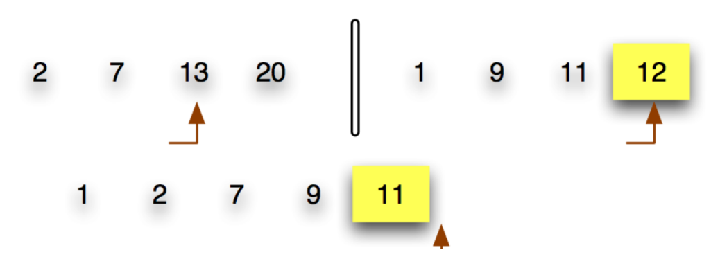
Merge (Simulation)

Slide 23
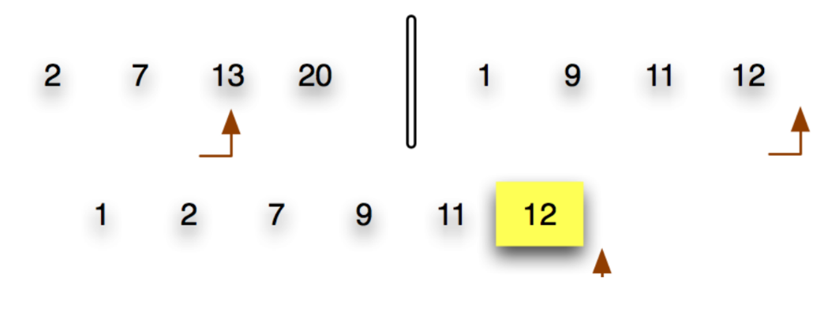
Merge (Simulation)

Slide 24
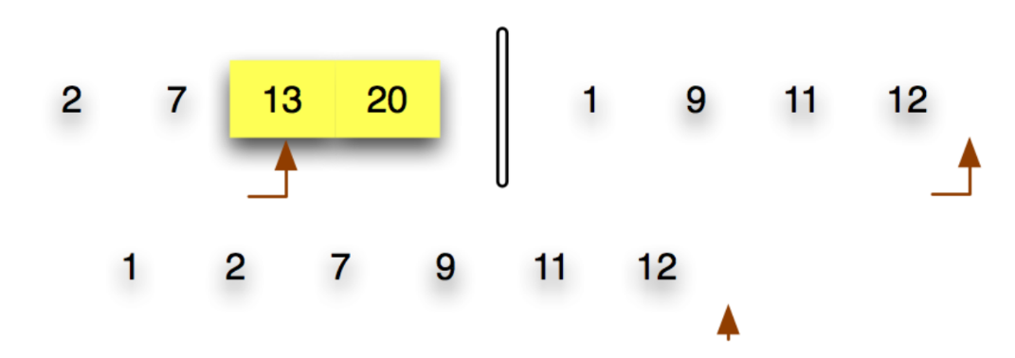
Merge (Simulation)

Slide 25
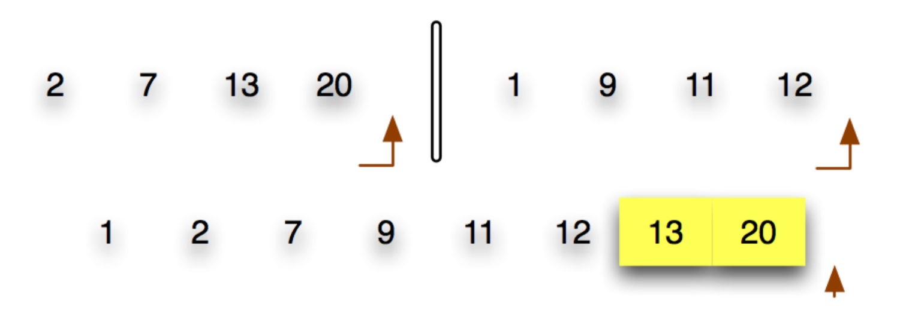
Merge (Simulation)

Slide 26
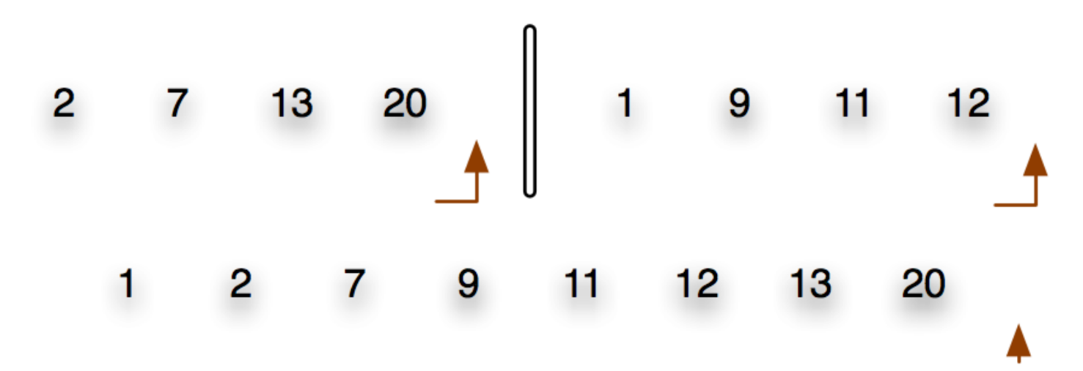
Merge (Simulation)

Slide 27
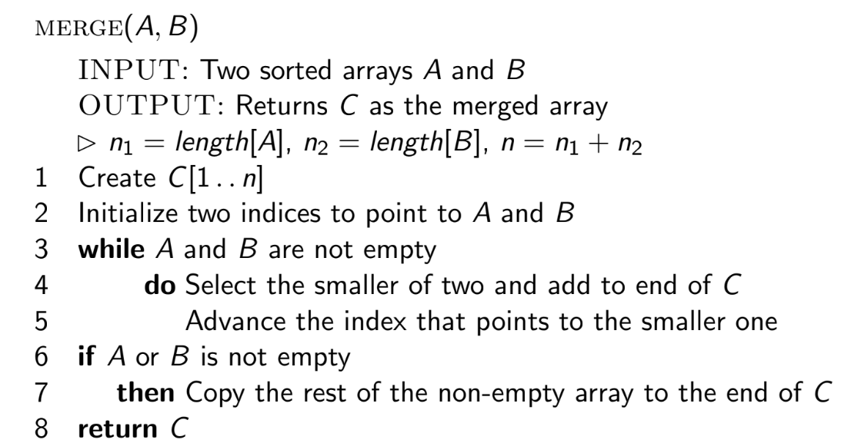
Merge (Algorithm)

Slide 28
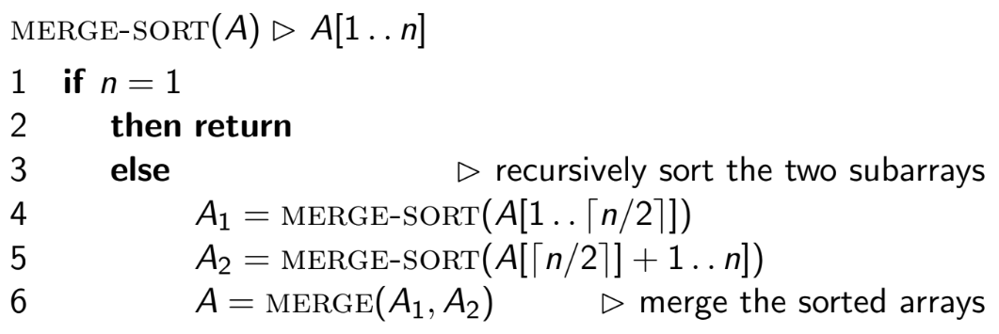
Merge Sort (Algorithm)
Out-of-Place Algorithm
Notes:
Time Complexity:
Best Case: O(n log n) Average Case: O(n log n) Worst Case: O(n log n)
Space Complexity:
Best/Average/Worst case: O(n).
Stable: Yes.
Inplace: No.

Slide 29
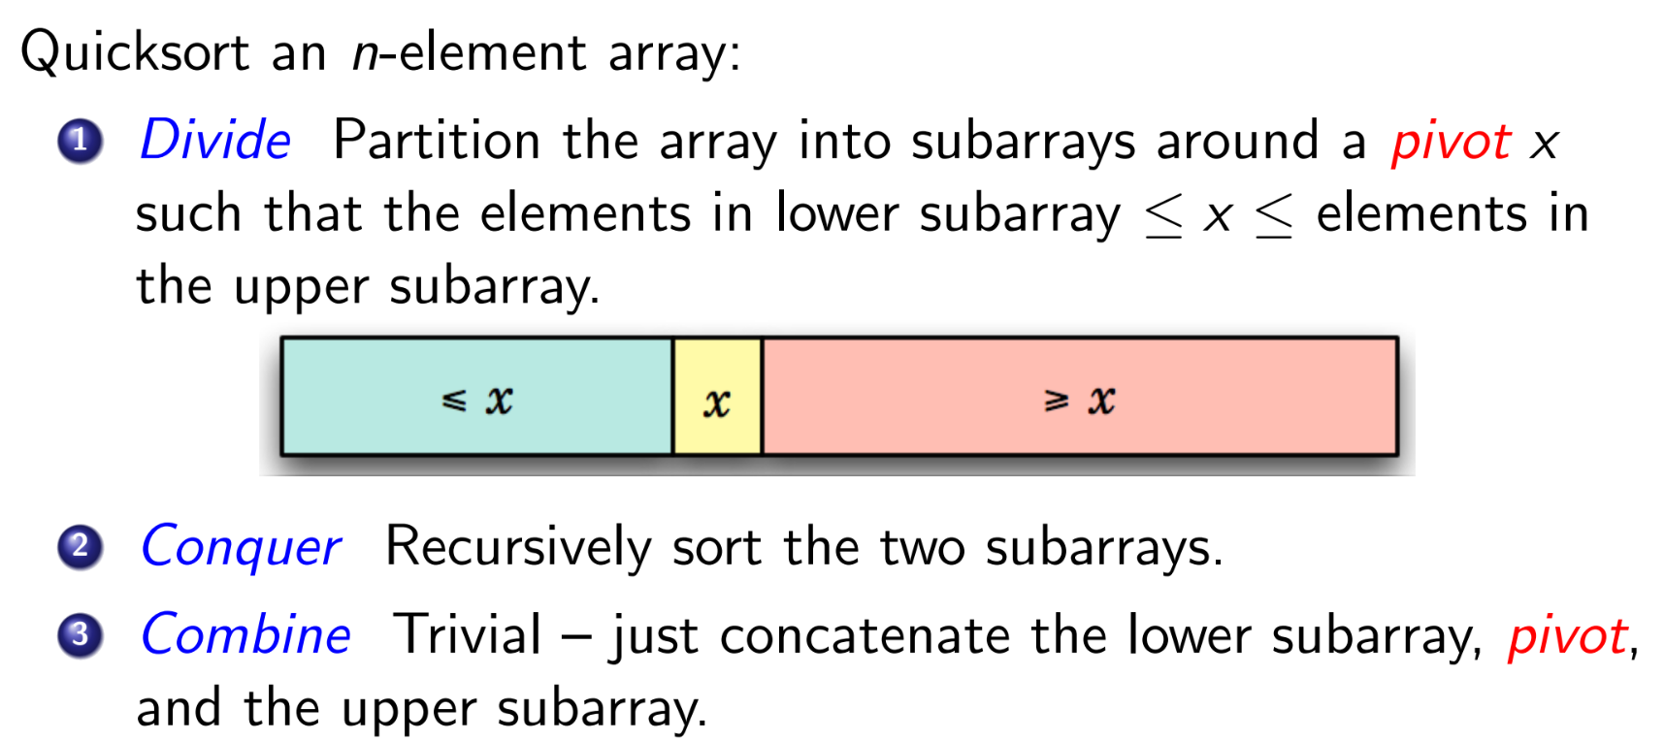
Quick Sort

Slide 30
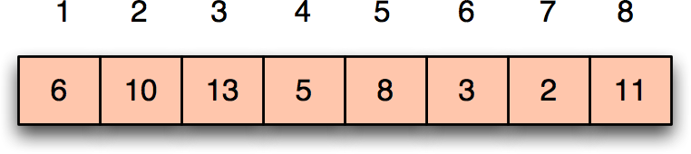
Quick Sort (Simulation)

Slide 31
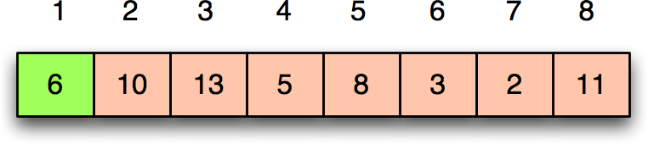
Quick Sort (Simulation)

Slide 32
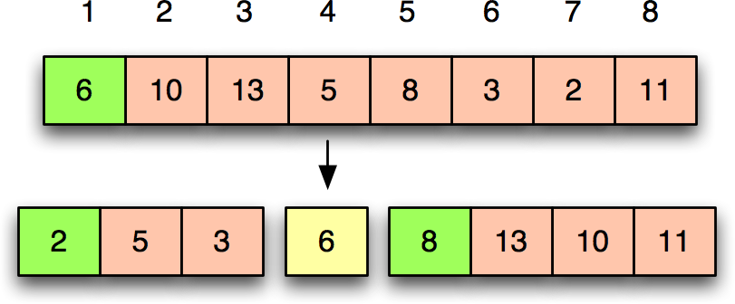
Quick Sort (Simulation)

Slide 33
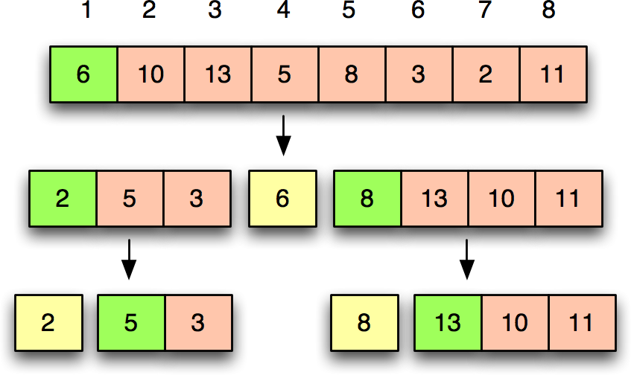
Quick Sort (Simulation)

Slide 34
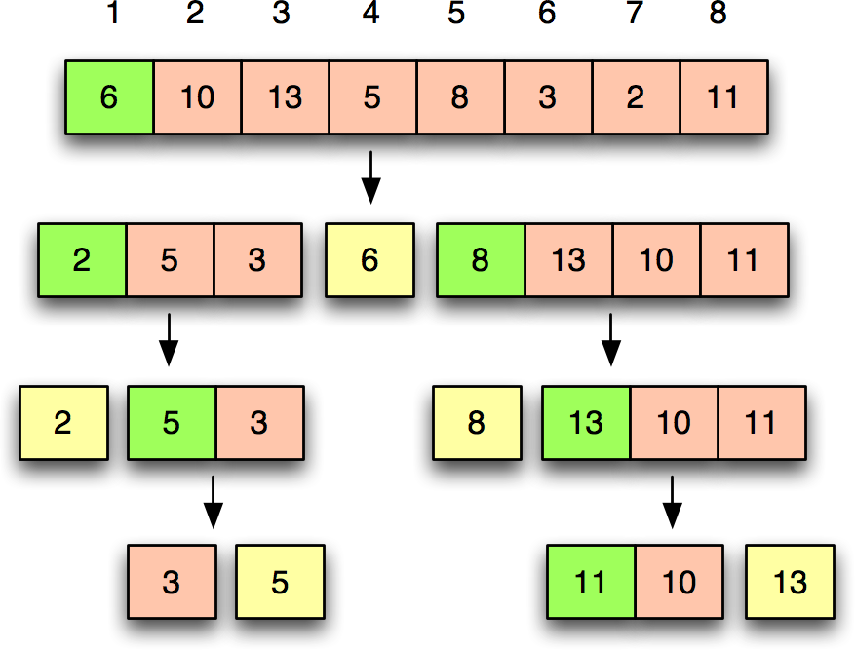
Quick Sort (Simulation)

Slide 35
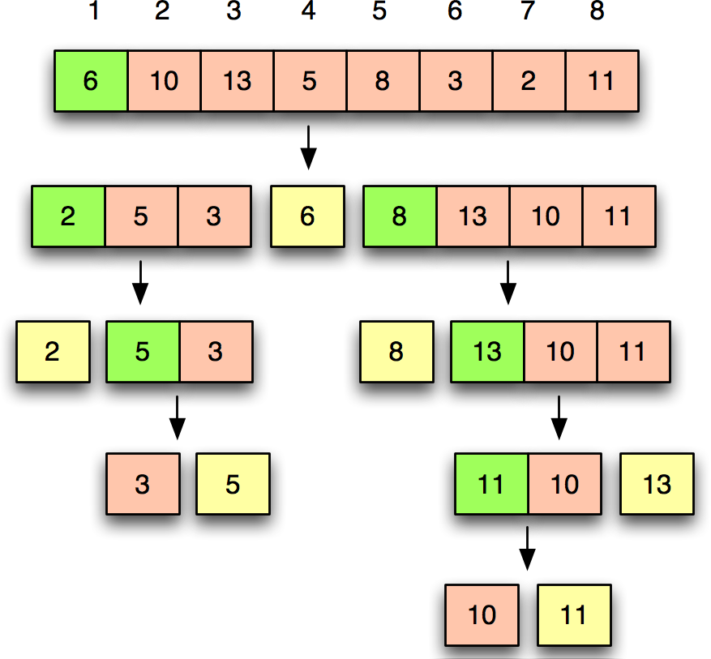
Quick Sort (Simulation)

Slide 36
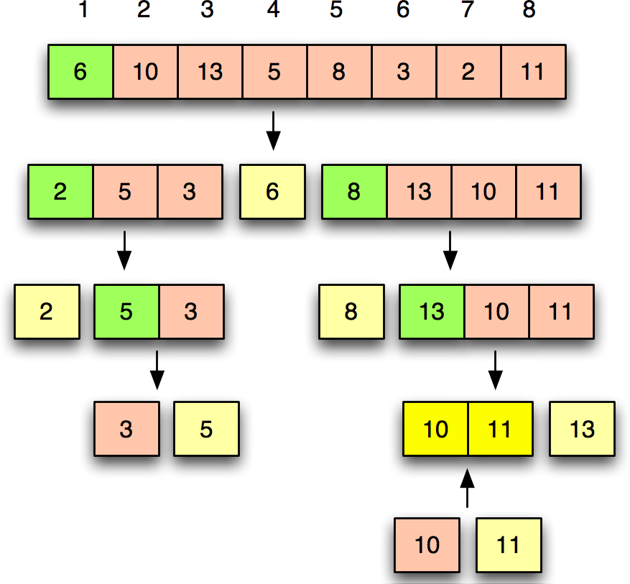
Quick Sort (Simulation)

Slide 37
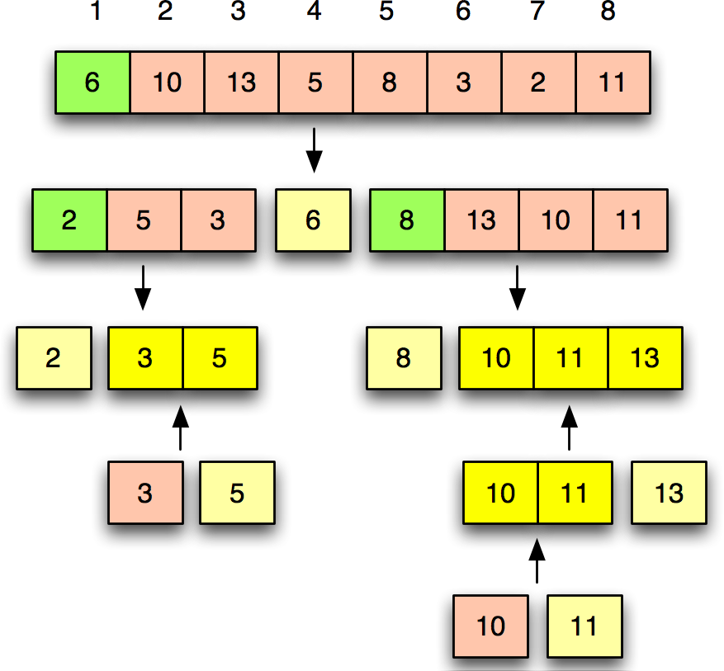
Quick Sort (Simulation)

Slide 38
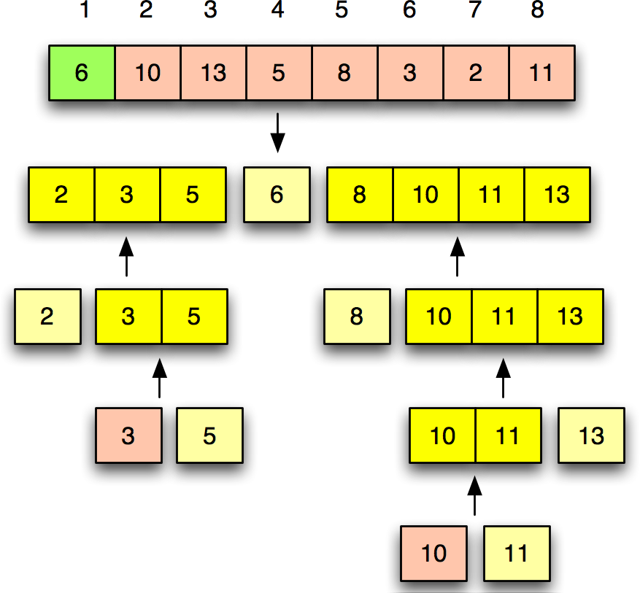
Quick Sort (Simulation)

Slide 39
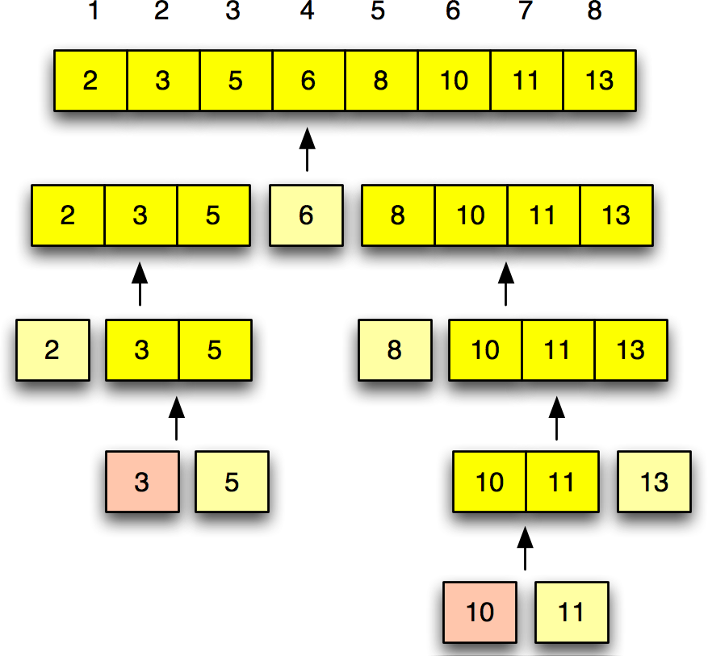
Quick Sort (Simulation)

Slide 40
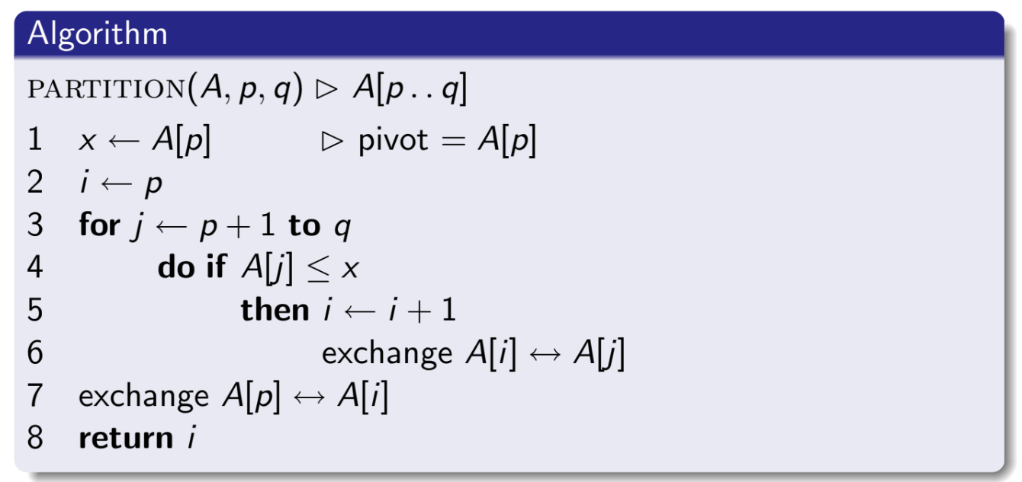
Partitioning (Algorithm)

Slide 41
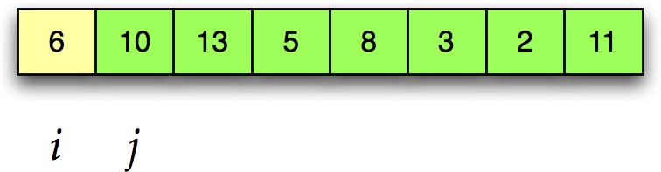
Partitioning (Simulation)

Slide 42
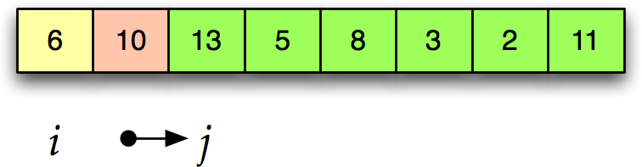
Partitioning (Simulation)

Slide 43
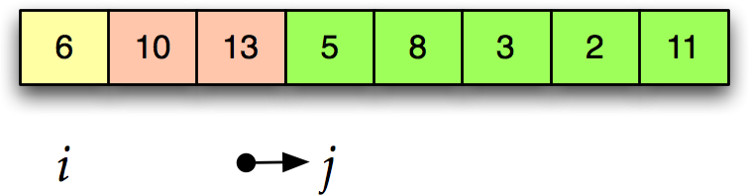
Partitioning (Simulation)

Slide 44
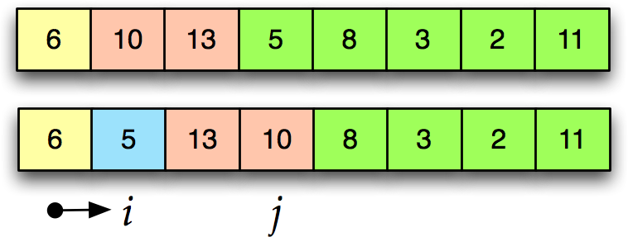
Partitioning (Simulation)

Slide 45
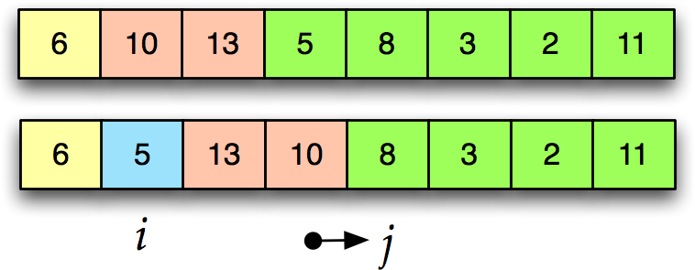
Partitioning (Simulation)

Slide 46
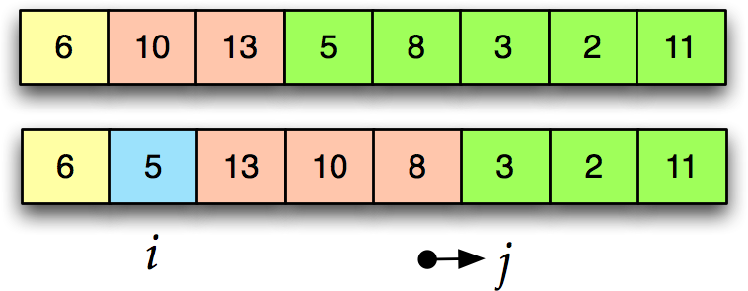
Partitioning (Simulation)

Slide 47
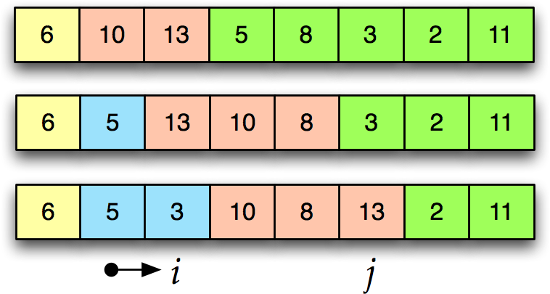
Partitioning (Simulation)

Slide 48
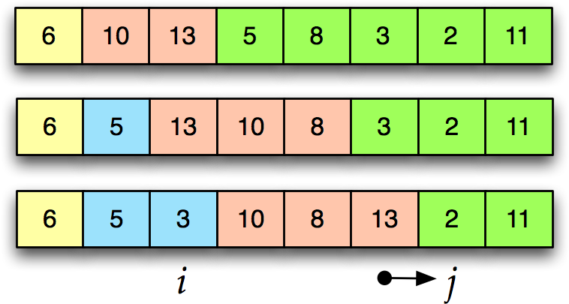
Partitioning (Simulation)

Slide 49
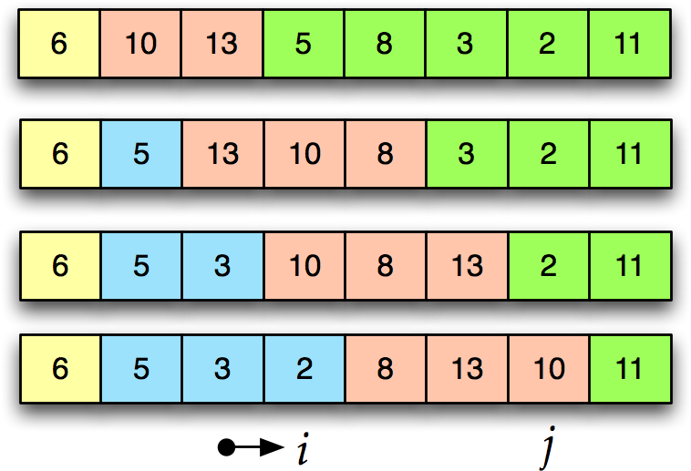
Partitioning (Simulation)

Slide 50
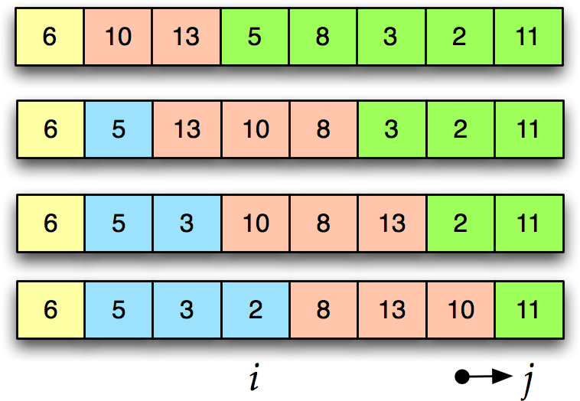
Partitioning (Simulation)

Slide 51
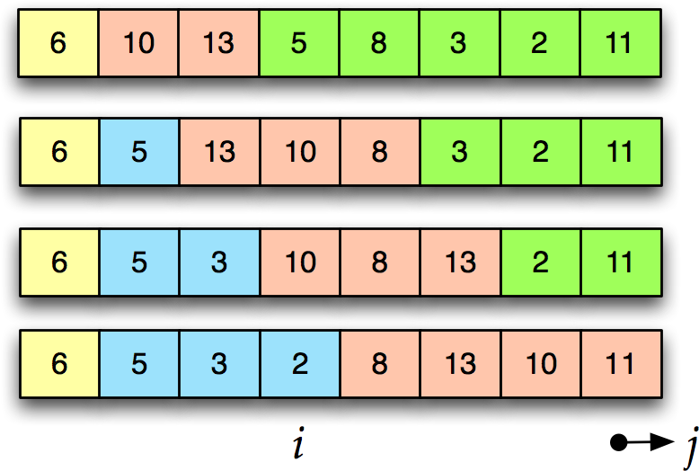
Partitioning (Simulation)

Slide 52
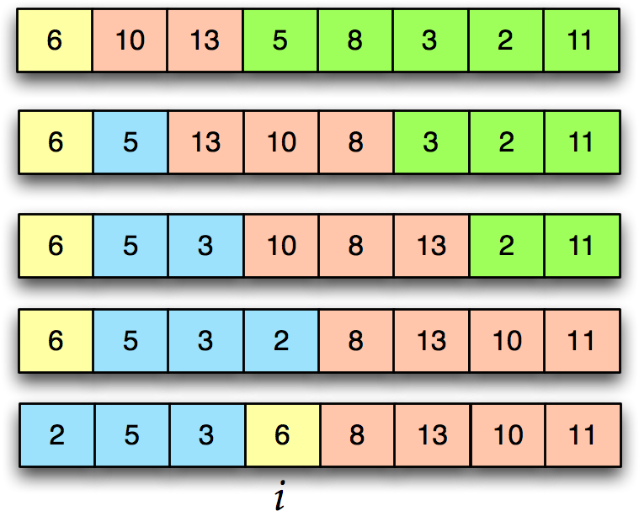
Partitioning (Simulation)

Slide 53
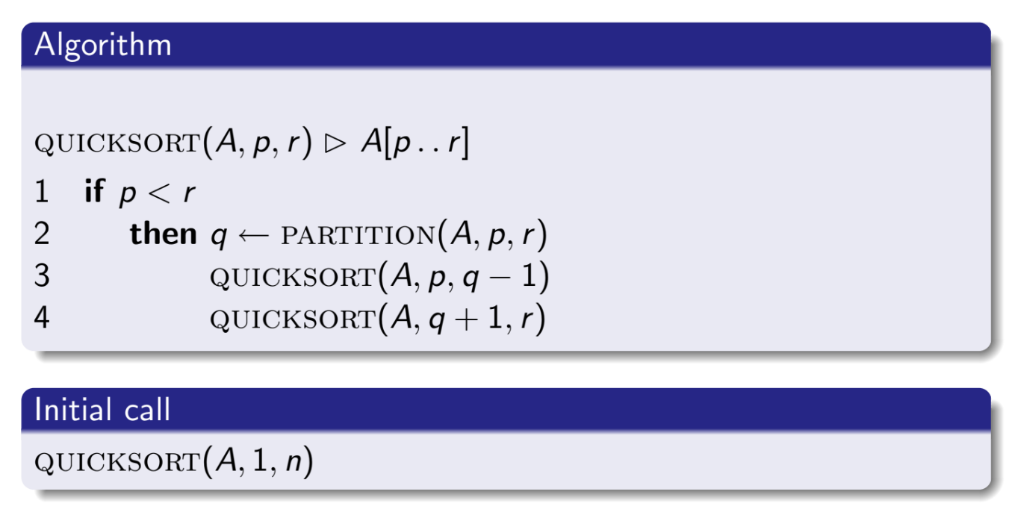
Quick Sort (Algorithm)
Notes:
Time Complexity:
Best Case: O(n log n) Average Case: O(n log n) Worst Case: O(n ^ 2) when partition always divides the array into subproblem of 0 and n-1
Space Complexity:
Best/Average/Worst case: O(1).
Stable: Yes.
Inplace: Yes.

Slide 54
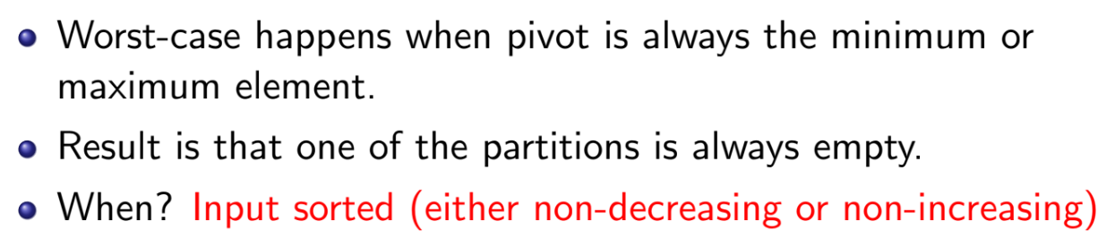
Quick Sort (Soft Analysis - Worst Case)
Notes:
Worst Case: O(n ^ 2) when partition always divides the array into subproblem of 0 and n-1

Slide 55
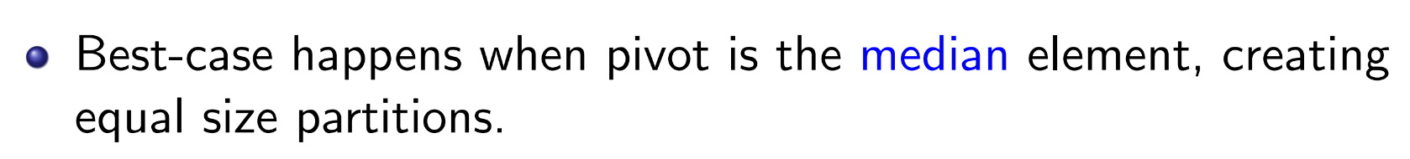
Quick Sort (Soft Analysis - Best Case)
Notes:
Best Case: O(n log n) when partition always divides the array into subproblems of (n-1)/2 - 1 and (n-1)/2

Slide 56
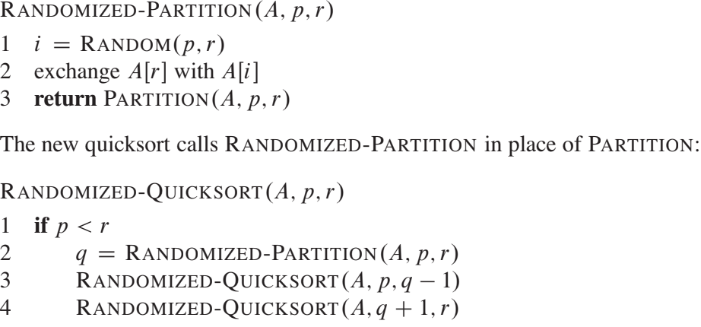
Randomized version of quicksort
Notes:
using RANDOMIZED-PARTITION, the expected running time of quicksort is O.n lg n/ when element values are distinct.

Slide 57
Counting Sort
It is a linear time sorting!
Complexity : O(n) | O(n + k) to be precise.
O(n) when k << n, where k is the range of the values in input array
It is not a comparison sort
It is a stable sorting algorithm
Only suitable for direct use in situations where the variation in keys is not significantly greater than the number of items.
Notes:
https://stackoverflow.com/questions/2572195/how-is-counting-sort-a-stable-sort

Slide 58
Idea of Counting sort
Suppose you know prior hand that all the values in the array are within 1 and k.
Take k boxes, 1 for each different value.
Put the value i in box i.
Each box contains elements equal to the frequency of the corresponding element
For sorting in increasing order, take out values from the smallest box to the largest box and place them in a new array, which will provide the sorted sequence

Slide 59
Implementation example
Array A : Main array
Array C : Counting box array
Array C’ : Keep cumulative sum of C
Array B : Build the sorted array

Slide 60
Pseudocode of Counting Sort
void counting_sort(int A[], int k, int n)
{
C[1…k] = 0; // initialize all elements in C array to 0
for (j = 1; j <= n; j++) // keep A[j] in C[A[j]]
C[A[j]] ++;
for (i = 1; i <= k; i++) // cumulative sum
C[i] = C[i] + C[i-1]; //instead of taking a separate array C’, update the array C with cumulative sum
for (j = n; j >= 1; j--) // put the sorted array in B
{
B[C[A[j]]] = A[j];
C[A[j]] --;
}
}

Slide 61
Counting-sort example
Input array
1
2
3
4
5
1
2
3
4
A:
4
1
3
4
3
C:
Count Array
&
cumulative Count Array
B:
output array

Slide 62
Loop 1
1
2
3
4
5
1
2
3
4
A:
4
1
3
4
3
C:
0
0
0
0
B:
C[1…k] = 0; // initialize all elements in C array to 0

Slide 63
Loop 2
1
2
3
4
5
1
2
3
4
A:
4
1
3
4
3
C:
0
0
0
1
B:
for (j = 1; j <= n; j++)
C[A[j]] ++;

Slide 64
Loop 2
1
2
3
4
5
1
2
3
4
A:
4
1
3
4
3
C:
1
0
0
1
B:
for (j = 1; j <= n; j++)
C[A[j]] ++;

Slide 65
Loop 2
1
2
3
4
5
1
2
3
4
A:
4
1
3
4
3
C:
1
0
1
1
B:
for (j = 1; j <= n; j++)
C[A[j]] ++;

Slide 66
Loop 2
1
2
3
4
5
1
2
3
4
A:
4
1
3
4
3
C:
1
0
1
2
B:
for (j = 1; j <= n; j++)
C[A[j]] ++;

Slide 67
Loop 2
1
2
3
4
5
1
2
3
4
A:
4
1
3
4
3
C:
1
0
2
2
B:
for (j = 1; j <= n; j++)
C[A[j]] ++;

Slide 68
Loop 3
1
2
3
4
5
1
2
3
4
A:
4
1
3
4
3
C:
1
0
2
2
B:
C':
1
1
2
2
C’ represents the state of C after C[i] = C[i] + C[i-1] operation
for (i = 1; i <= k; i++)
C[i] = C[i] + C[i-1];

Slide 69
Loop 3
1
2
3
4
5
1
2
3
4
A:
4
1
3
4
3
C:
1
0
2
2
B:
C':
1
1
3
2
C’ represents the state of C after C[i] = C[i] + C[i-1] operation
for (i = 1; i <= k; i++)
C[i] = C[i] + C[i-1];

Slide 70
Loop 3
1
2
3
4
5
1
2
3
4
A:
4
1
3
4
3
C:
1
0
2
2
B:
C':
1
1
3
5
C’ represents the state of C after C[i] = C[i] + C[i-1] operation
for (i = 1; i <= k; i++)
C[i] = C[i] + C[i-1];

Slide 71
Loop 4
1
2
3
4
5
1
2
3
4
A:
4
1
3
4
3
C:
1
1
3
5
B:
3
C':
1
1
2
5
for (j = n; j >= 1; j--)
{
B[C[A[j]]] = A[j];
C[A[j]] --;
}
C’ represents the state of C after C[A[j]]-- operation

Slide 72
Loop 4
1
2
3
4
5
1
2
3
4
A:
4
1
3
4
3
C:
1
1
2
5
B:
3
4
C':
1
1
2
4
for (j = n; j >= 1; j--)
{
B[C[A[j]]] = A[j];
C[A[j]] --;
}
C’ represents the state of C after C[A[j]]-- operation

Slide 73
Loop 4
1
2
3
4
5
1
2
3
4
A:
4
1
3
4
3
C:
1
1
2
4
B:
3
3
4
C':
1
1
1
4
for (j = n; j >= 1; j--)
{
B[C[A[j]]] = A[j];
C[A[j]] --;
}
C’ represents the state of C after C[A[j]]-- operation

Slide 74
Loop 4
1
2
3
4
5
1
2
3
4
A:
4
1
3
4
3
C:
1
1
1
4
B:
1
3
3
4
C':
0
1
1
4
for (j = n; j >= 1; j--)
{
B[C[A[j]]] = A[j];
C[A[j]] --;
}
C’ represents the state of C after C[A[j]]-- operation

Slide 75
Loop 4
1
2
3
4
5
1
2
3
4
A:
4
1
3
4
3
C:
0
1
1
4
B:
1
3
3
4
4
C':
0
1
1
3
for (j = n; j >= 1; j--)
{
B[C[A[j]]] = A[j];
C[A[j]] --;
}
C’ represents the state of C after C[A[j]]-- operation

Slide 76
Analysis of Counting Sort
Θ(k)
C[1…k] = 0;
Θ(n)
for (j = 1; j <= n; j++)
C[A[j]] ++;
Θ(k)
for (i = 1; i <= k; i++)
C[i] = C[i] + C[i-1];
for (j = n; j >= 1; j--)
{
B[C[A[j]]] = A[j];
C[A[j]] --;
}
Θ(n)
Θ(n + k)

Slide 77
Counting Sort Extended
What if the numbers are ranged from 100,000,000 to 100,000,100?
What if the numbers are ranged from -1000 to 1000?
All we need is the range between highest and lowest number.

Slide 78
Properties of Counting Sort
Time Complexity:
Best Case: O(n+k) when array is sorted already.
Average Case: O(n+k) when array is in random order.
Worst Case: O(n+k) when array is in reverse order.
Space Complexity:
Best/Average/Worst case: O(k).
Stable: Yes.
Inplace: No.
Suitable for arrays with small range of data i.e. where the difference between the largest and the smallest element of the array is not very big.

